Slide 1
Spring Boot with Embedded Database

Slide 2
Agenda: Understanding of Embedded database H2 and When to use Embedded Database H2
●Understanding of Embedded database
●Diagram : Where and how does Embedded database runs
●When to use H2 Database ?

Slide 3
Understanding of Embedded database

Slide 4
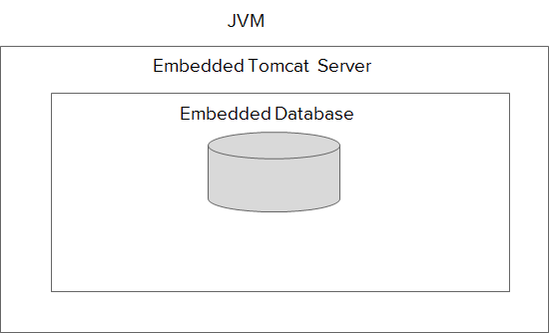
Diagram: Where and how does the embedded database run

Slide 5
When to use H2 Database ?
●When temporary data storage is required.
●When architecting your application from scratch.
●When you do not have too much data to store.
●Until your company has not provisioned infra or cloud setup for database.
●It also good if you are creating some technical POC or POT or MVP

Slide 6
Summary
In this task we have understood what is an embedded database, then we have seen a diagram which explains where and how does embedded database runs, then we have learned about when to use embedded database,

Slide 7
Agenda: What are entity classes?
@Entity
public class Employee{
@Id
private long id;
private String name;
private int age;
private String salary;
//Getters and Setters ………...
}
id | name | age | salary
1 | Samarth Narula | 26 | 10000
2 | Sahil Shah | 26 | 8000

Slide 8
Summary
In this task we have learned about what are entity classes and how it gets mapped to a database table and in the next task we will learn about how to configure and access the H2 console UI.

